Slide 1
Data analysis

Slide 2
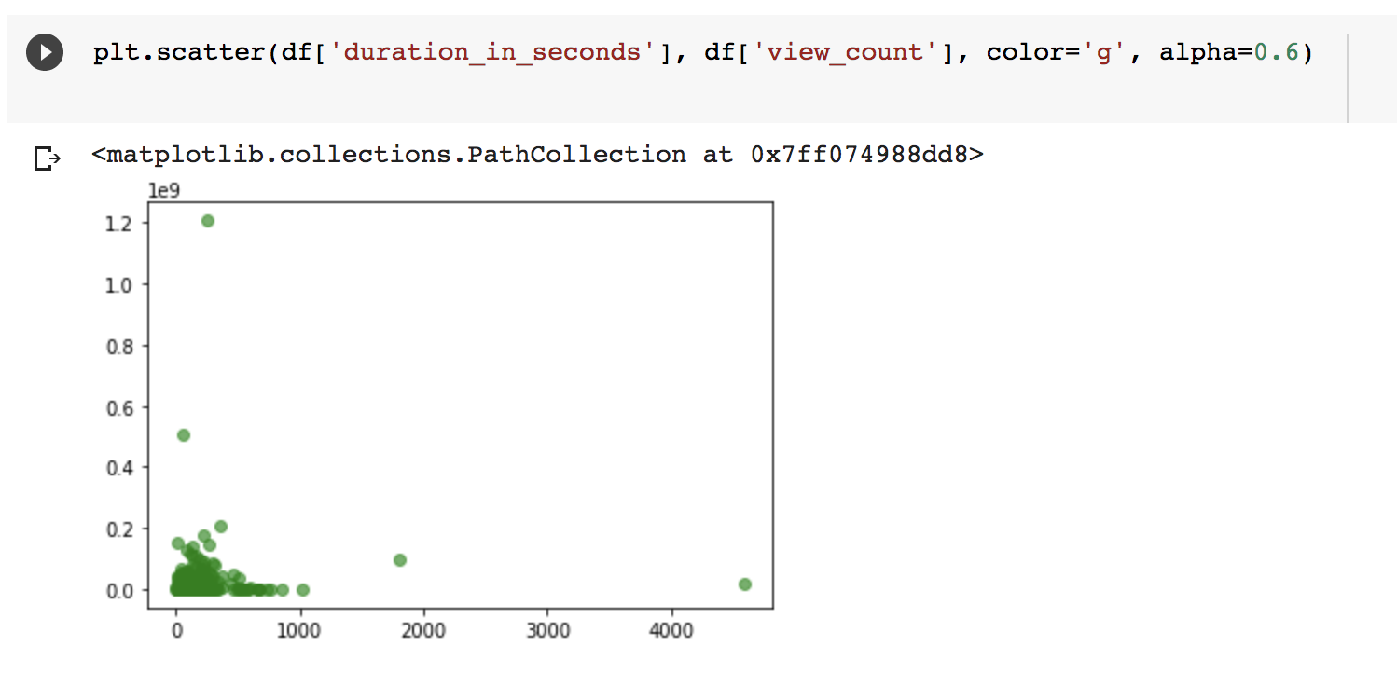
Cluster in bottom left
None greater than 16.6 min in duration
Most viral videos have a duration of 500 s or lower (8.33 min or lower)
To do: remove outliers and zoom in to get greater details
Mention that views come after the video gets viral
Comment: seems YT wanted to make videos longer to put more ads
Look into how YT attributes revenue

Slide 3
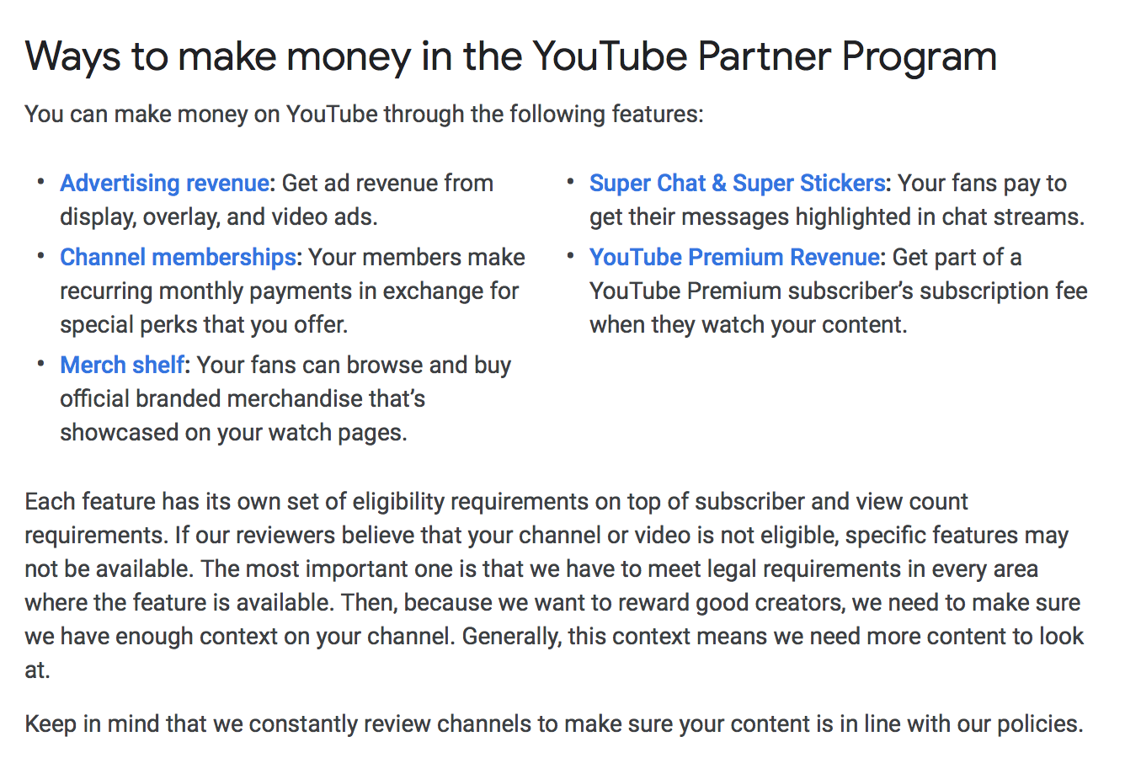

Slide 4
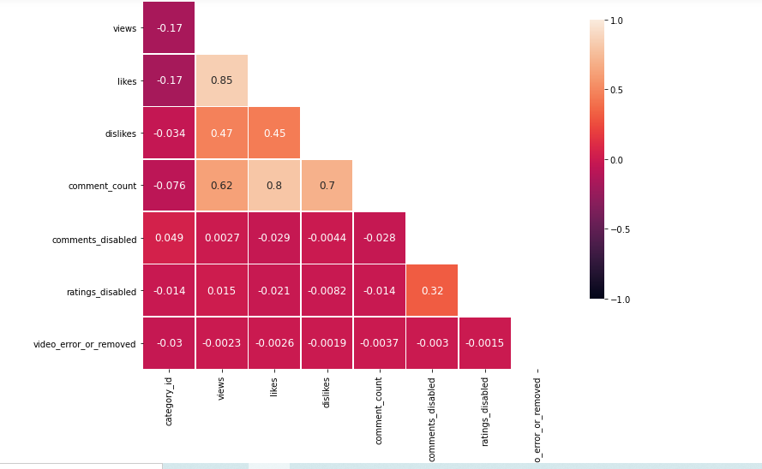
Correlation heatmap for the US trending videos
The highest positive correlation is between likes and views with a value of 0.85.There is also a significant positive correlation between the number of comments and the number of likes, and the number of comments and dislikes.
There is a positive correlation yet less significant between the number of comments and views, dislikes and views and dislikes and likes.
Since there is a high positive correlation between between likes and views, we want to examine this in greater depth by plotting a scatter plot between
Notes:
The highest positive correlation is between likes and views with a value of 0.85.There is also a significant positive correlation between the number of comments and the number of likes, and the number of comments and dislikes.
There is a positive correlation yet less significant between the number of comments and views, dislikes and views and dislikes and likes.

Slide 5
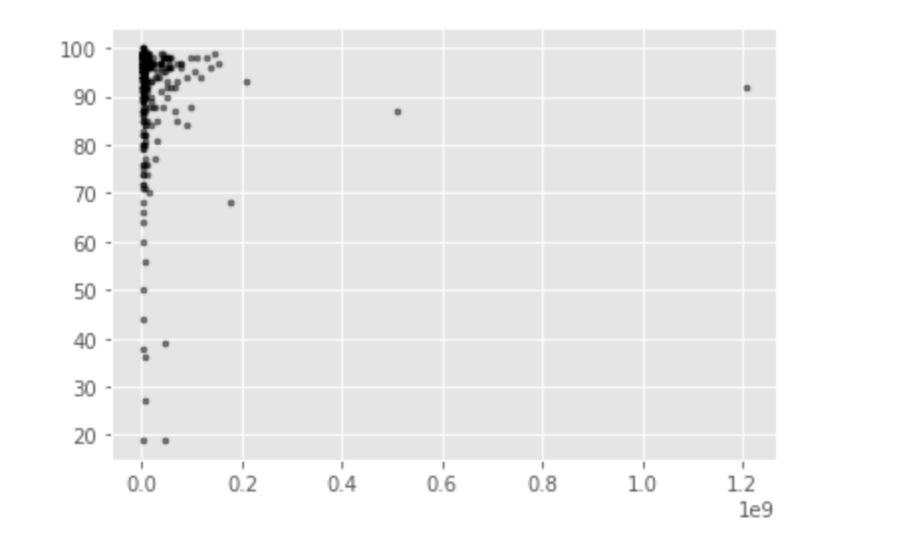
Is this for trending or viral? Is it the same as slide 6?
Number of Likes
Views

Slide 6
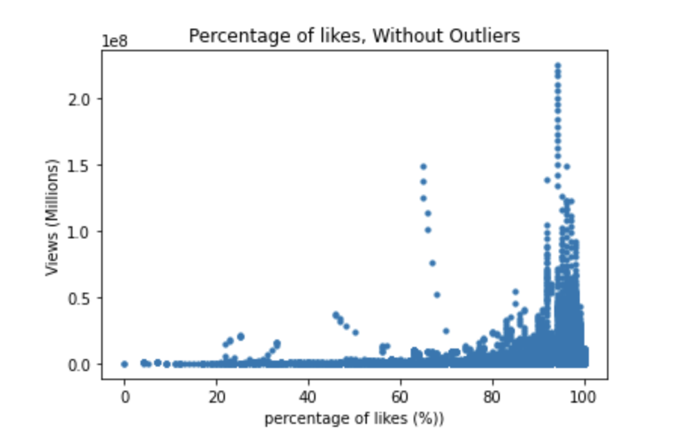
Trending

Slide 7
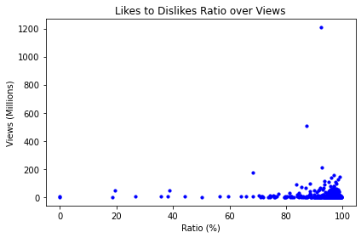
Notes:
V

Slide 8
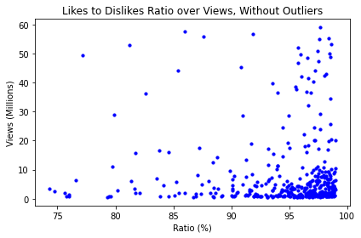

Slide 9
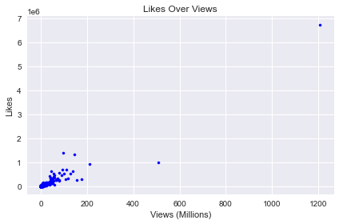

Slide 10
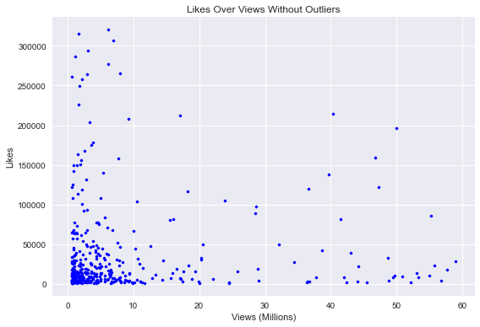
Notes:
Philippine

Slide 11
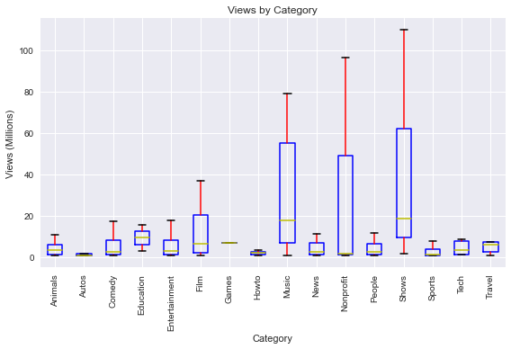
Jorge

Slide 12
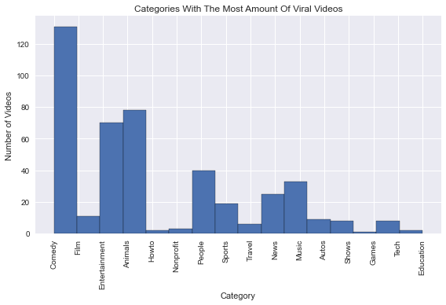
Notes:
Philippine

Slide 13
